Slide 1
Static Dashboard: Analyzing Crime Trends in 4 Northeast Cities
Frankie Way & Brian Waters

Slide 2
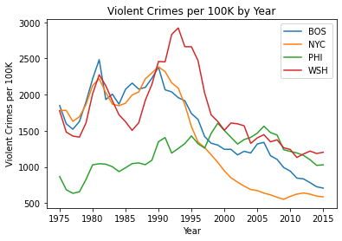
Non-normal Distributions of Violent Crime
Small sample size of 40 years.
Perform Wilcoxon Rank-Sum test to find statistically different distributions
Boston/Philadelphia
New York/Washington D.C
Philadelphia/Washington D.C.

Slide 3
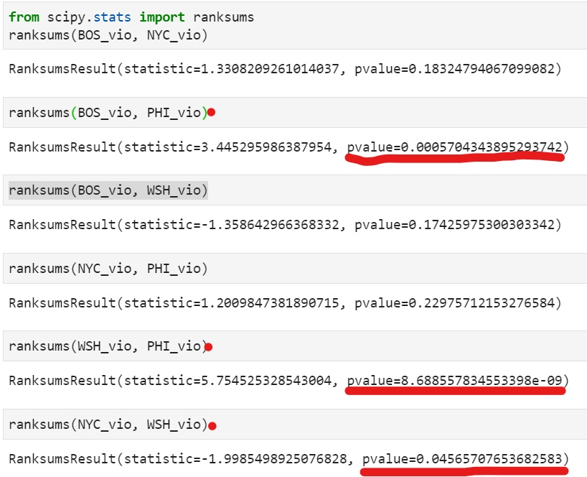
Results of Wilcoxon Rank-Sum Test
Highlighted = statistically significant
Significance Level of α=0.05
NYC/WSH just makes cut

Slide 4
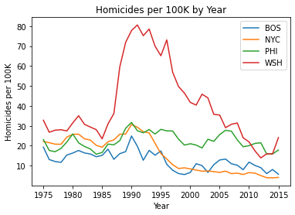
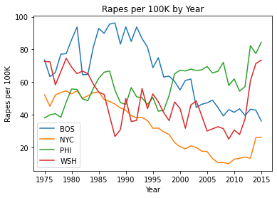
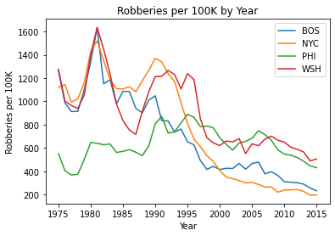
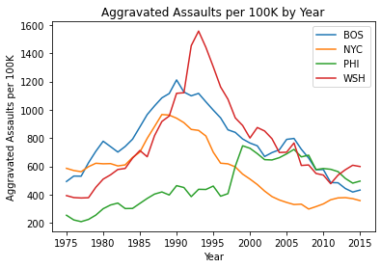

Slide 5
Negative to no correlation in the first two columns, New York/DC has some higher correlations, but .48-.62 can still be considered low enough to have discrepancies in the distribution. The p-value of the Wilcoxon Rank-Sum test was 0.045, so if our arbitrary selection of the alpha-value was say 0.01, this pair would not have made our further analysis
City Pair/ Type of Crime | Boston/Philadelphia | Washington D.C./Philadelphia | New York City/Washington D.C.
Homicides/100K | 0.3595818815331011 | 0.71602787456446 | 0.5566202090592335
Rapes/100K | -0.504006968641115 | -0.2418118466898955 | 0.6257839721254357
Robberies/100K | 0.0348432055749129 | 0.2804878048780488 | 0.8766550522648086
Agg. Assaults/100K | -0.04738675958188154 | 0.32229965156794427 | 0.48222996515679456

